Slide 1


Appointment Scheduling System Demo
Douglas Honors College – Capstone Project
Developer – Guzaloi Noori
Mentor – Dr. Shawn Reichert
Second Reader – Roslyn Moes

Slide 2


Home Page

Slide 3
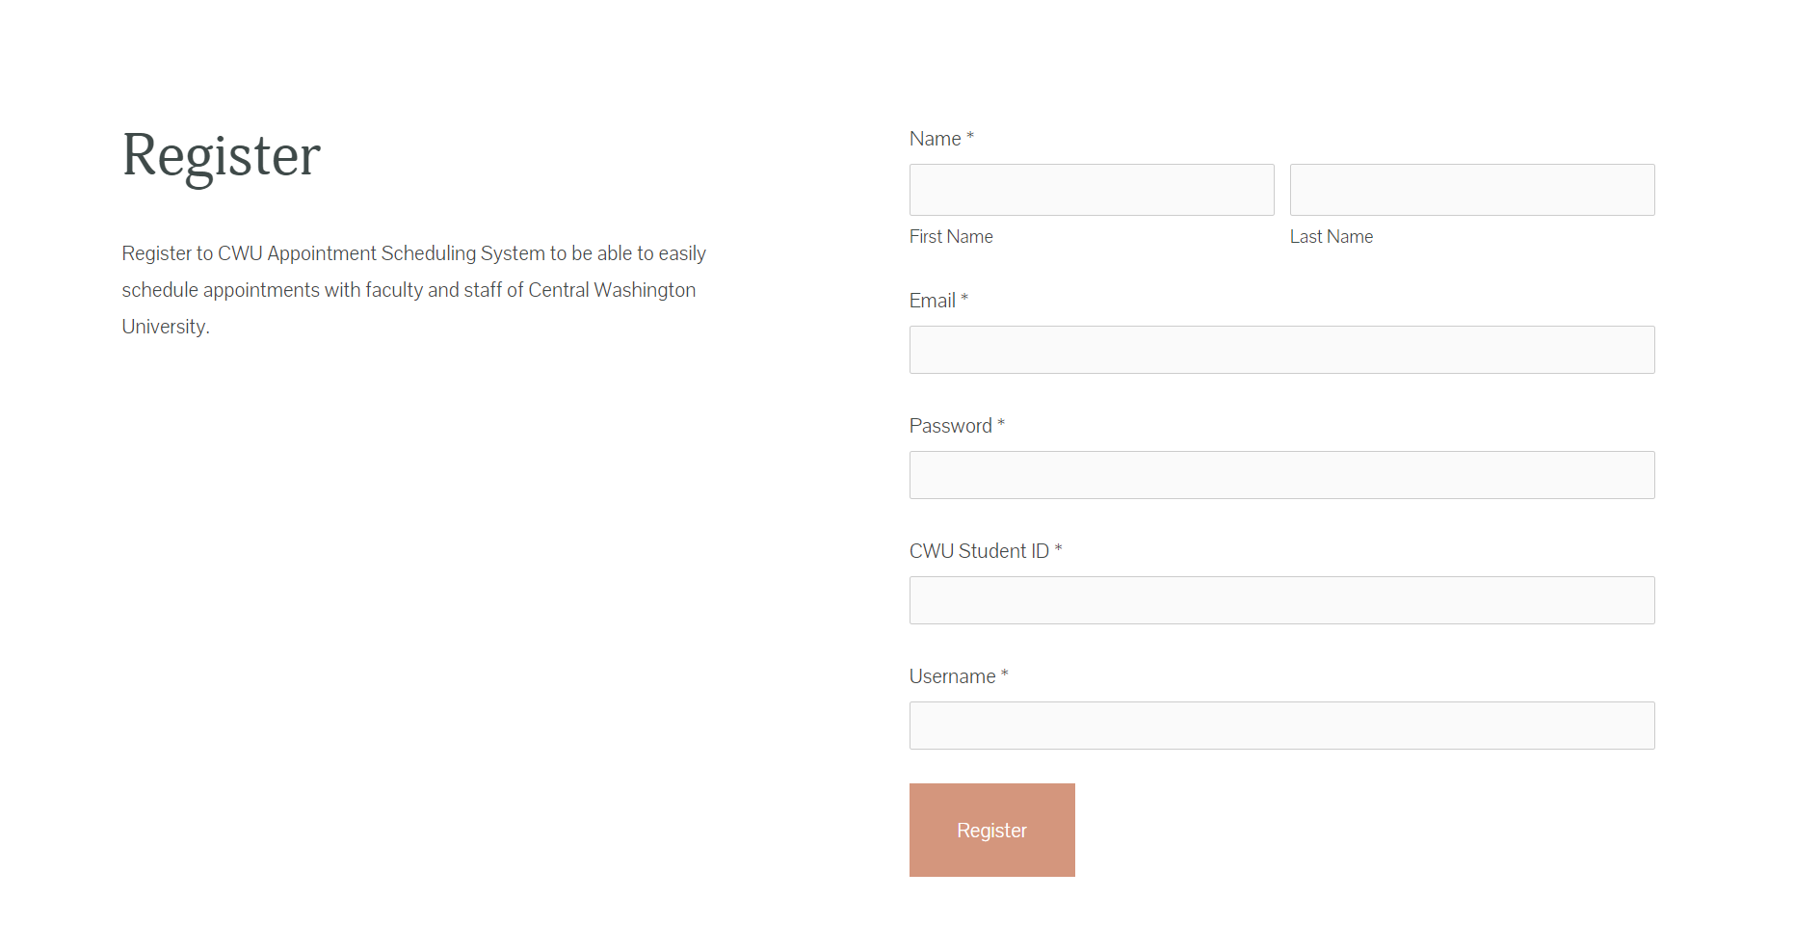
Register

Slide 4
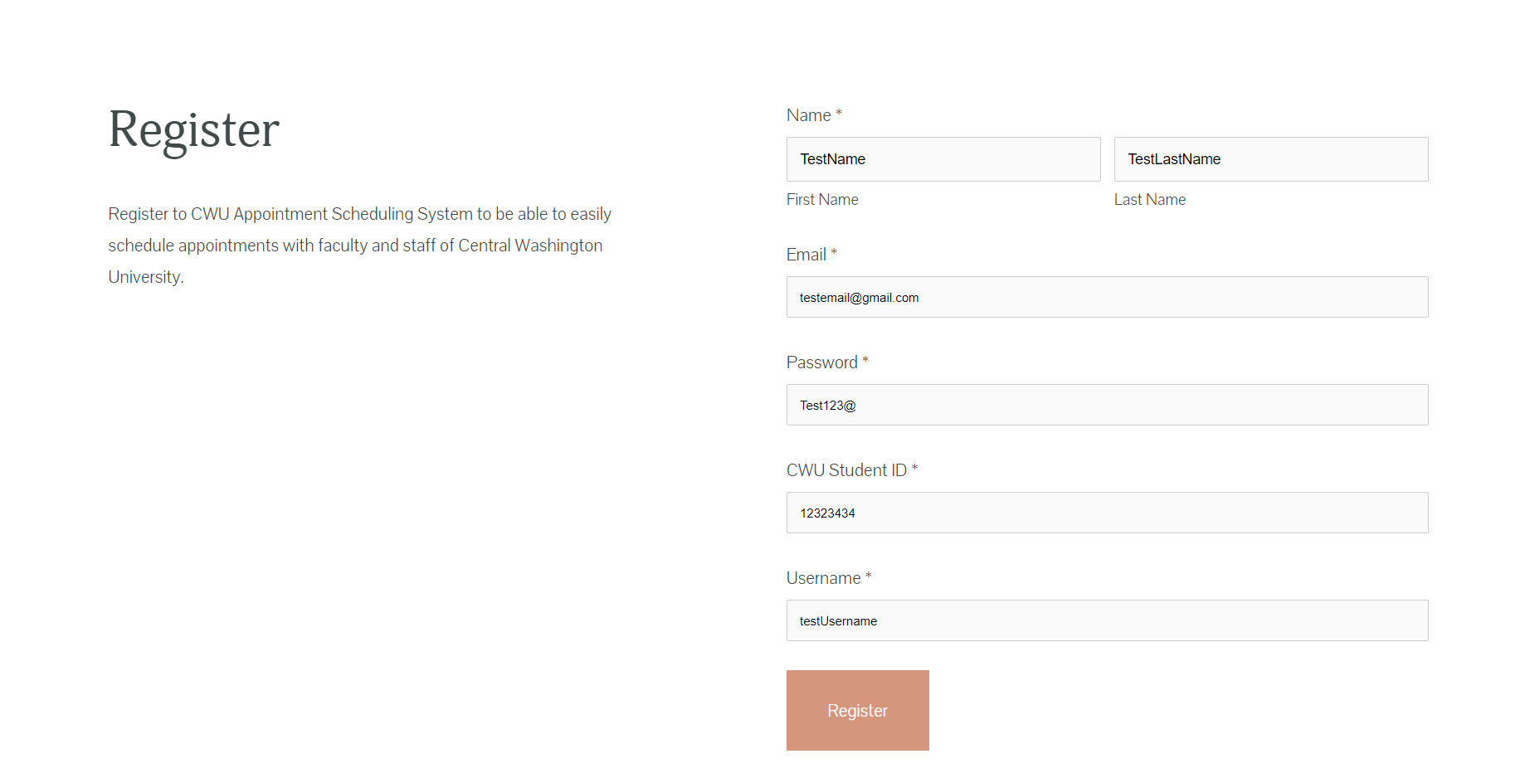
Register Info

Slide 5
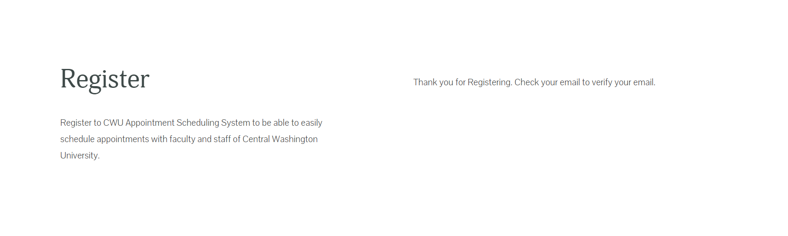
Registration Confirmation

Slide 6

Sign In

Slide 7
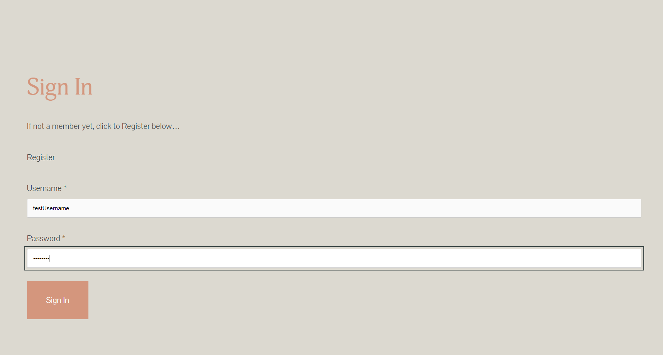
Sign in input

Slide 8
Home Page

Slide 9
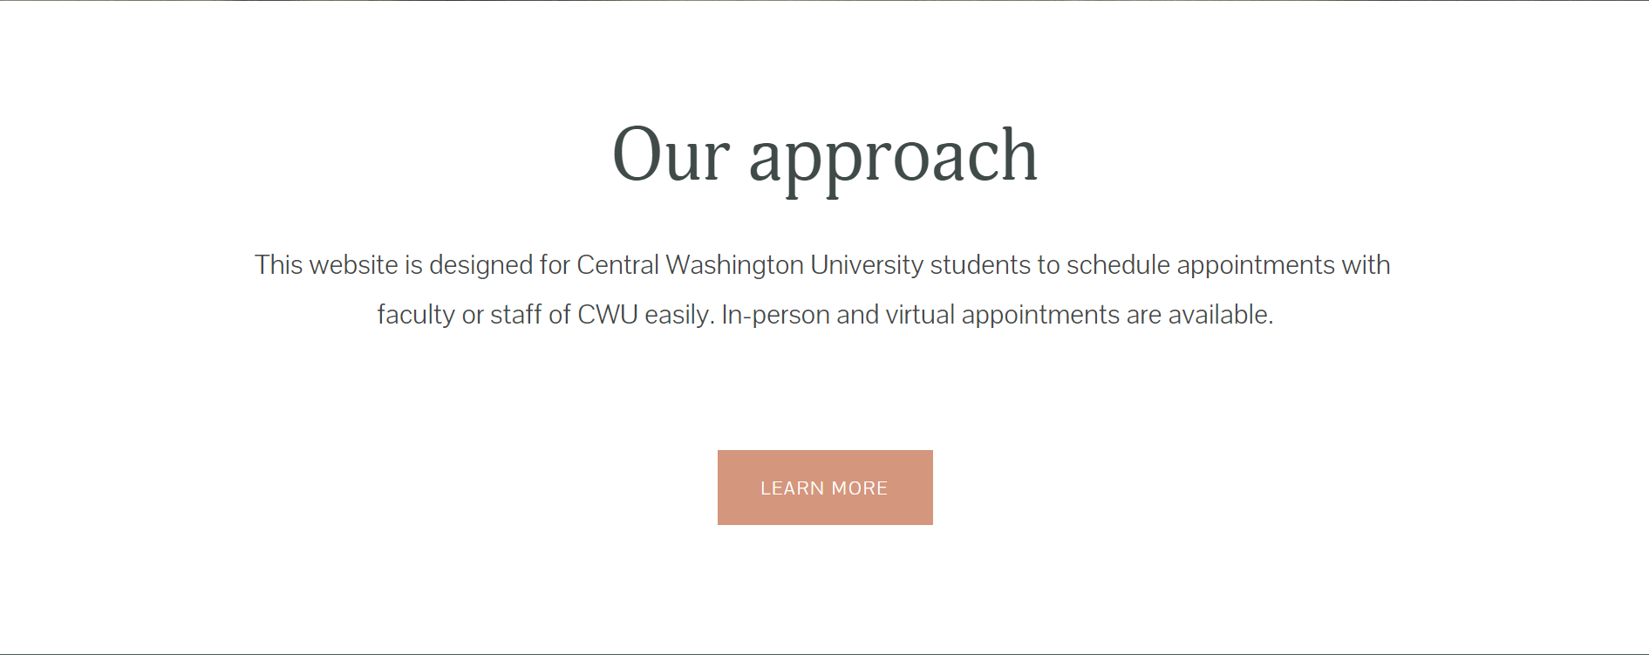
Home Page 2

Slide 10

Approach Button

Slide 11

Services Intro

Slide 12
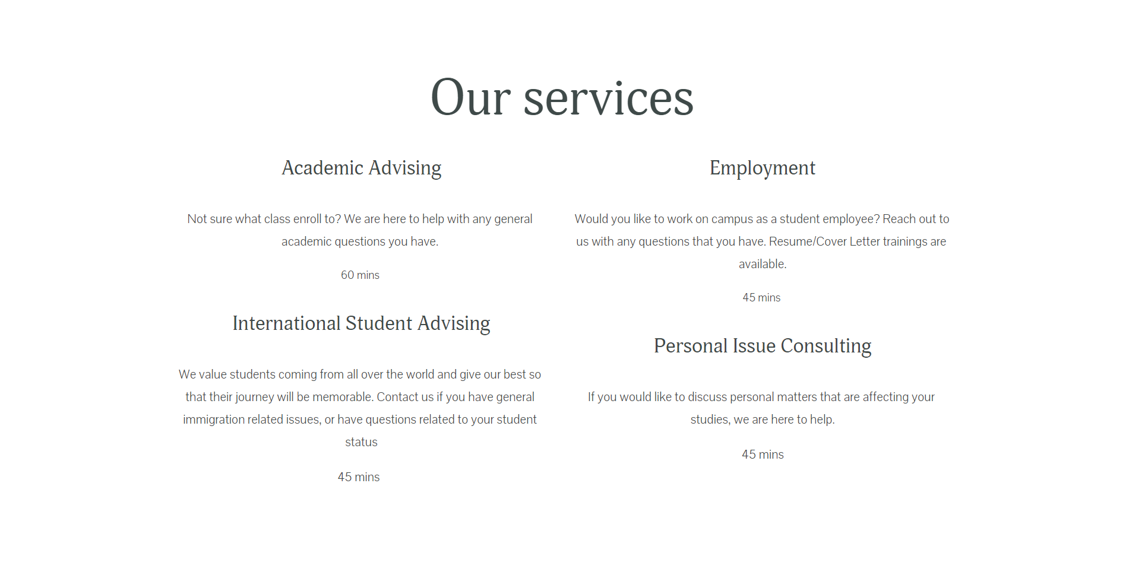
Services

Slide 13
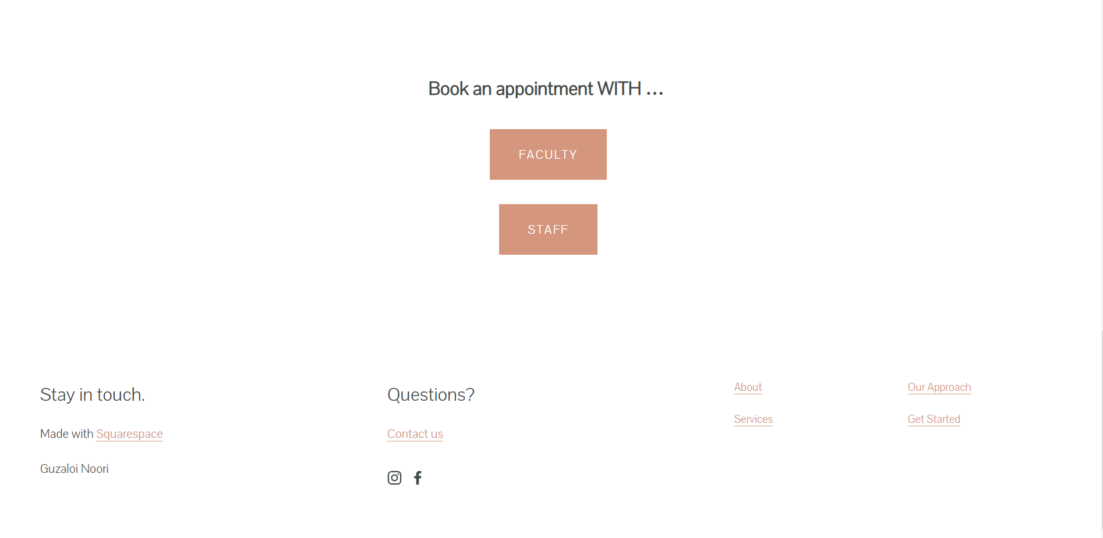
Book an appointment

Slide 14

Schedule Appointment

Slide 15
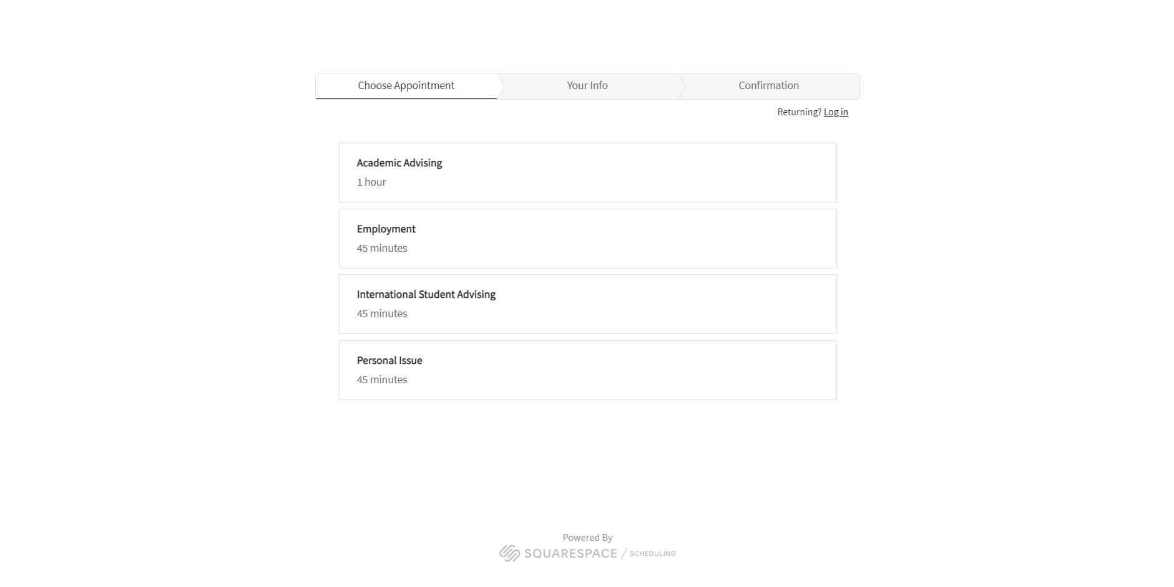
Appointment options

Slide 16
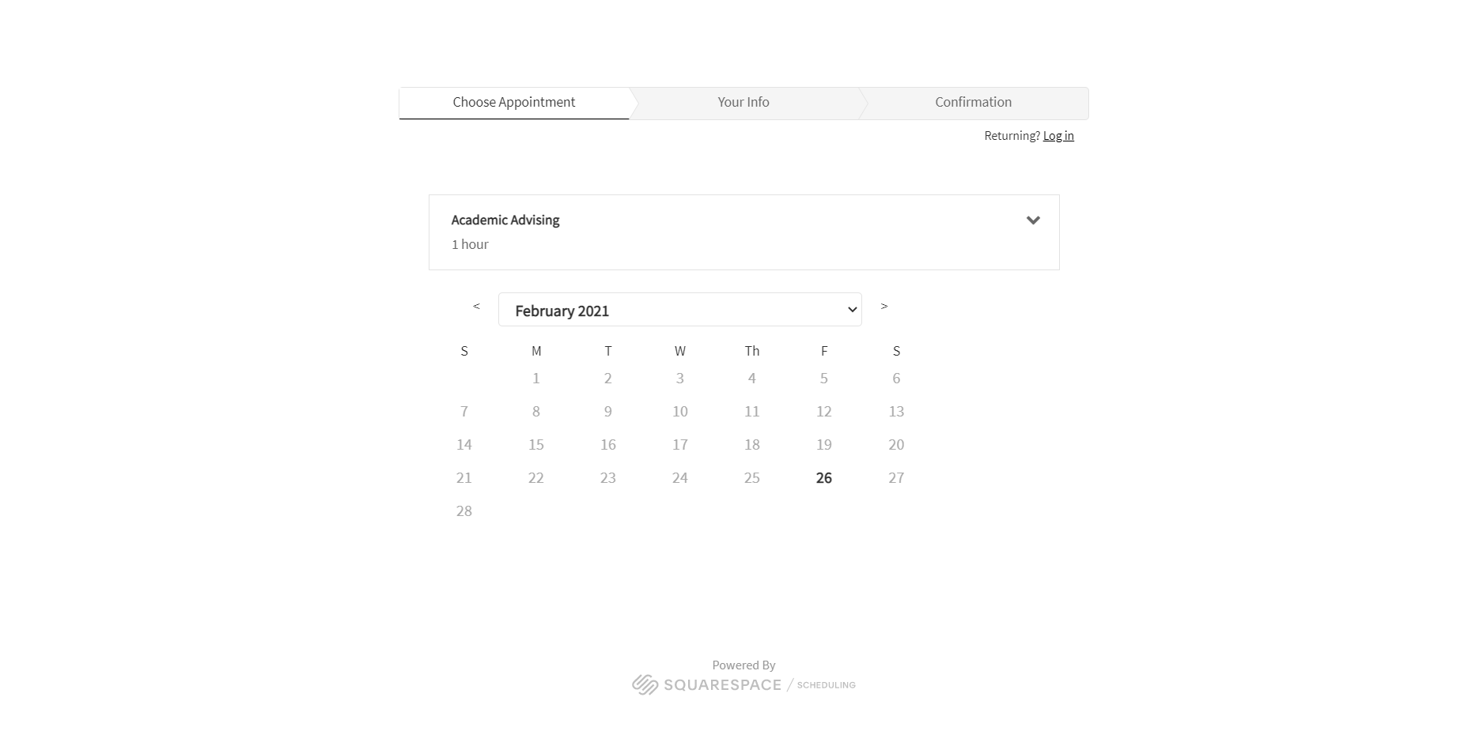
Scheduling date

Slide 17
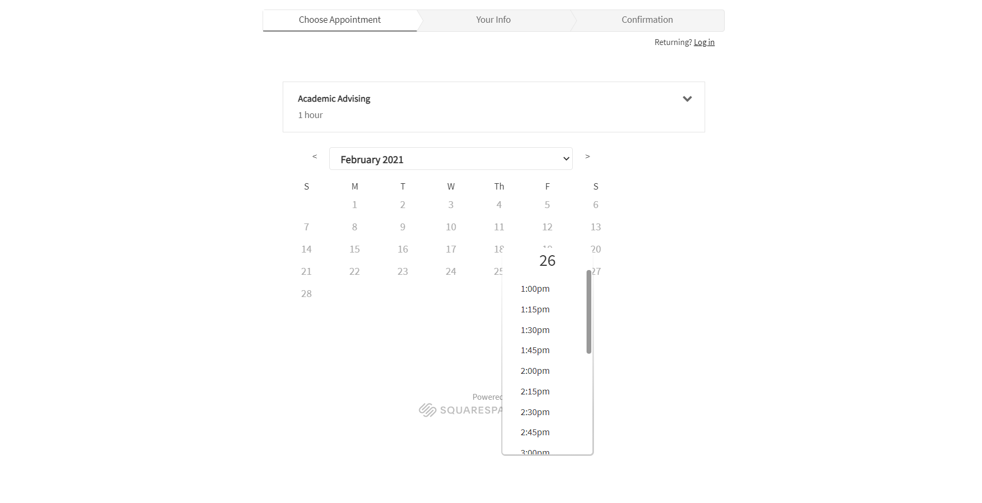
Scheduling time

Slide 18
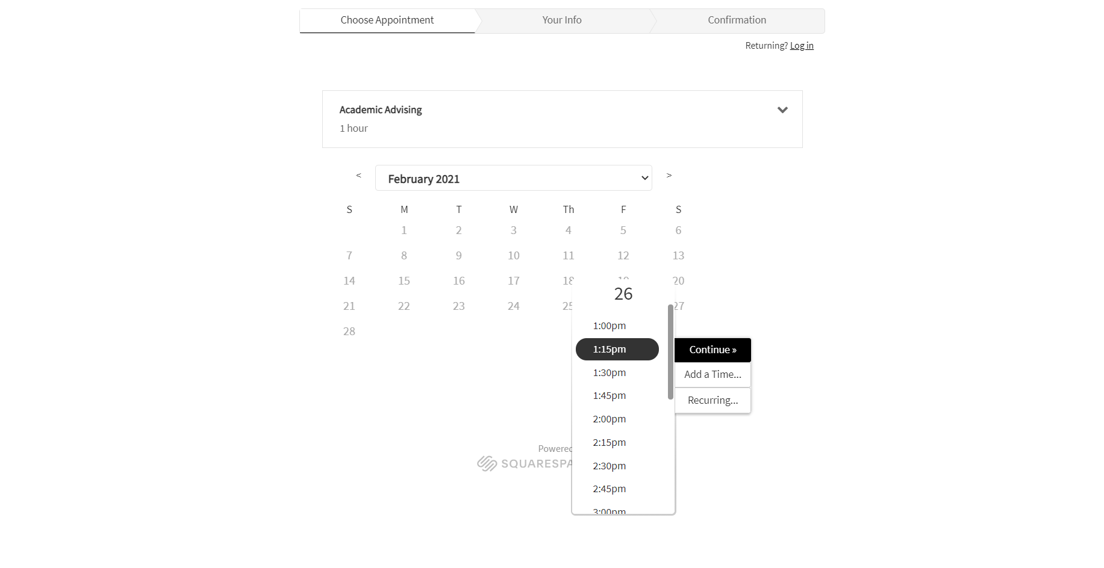
Scheduling date/time cont

Slide 19
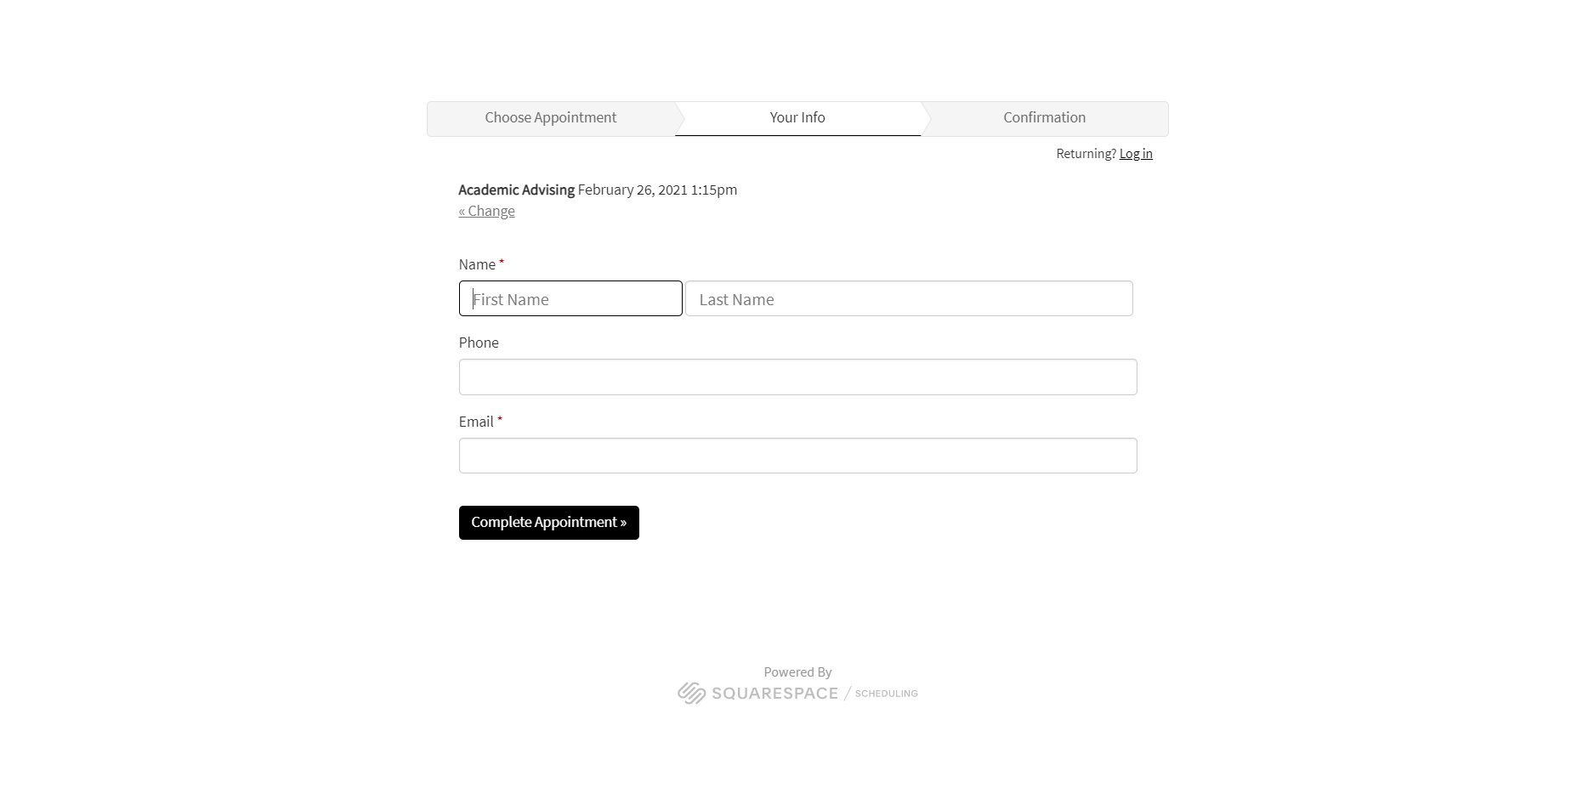
Appointment – your information

Slide 20
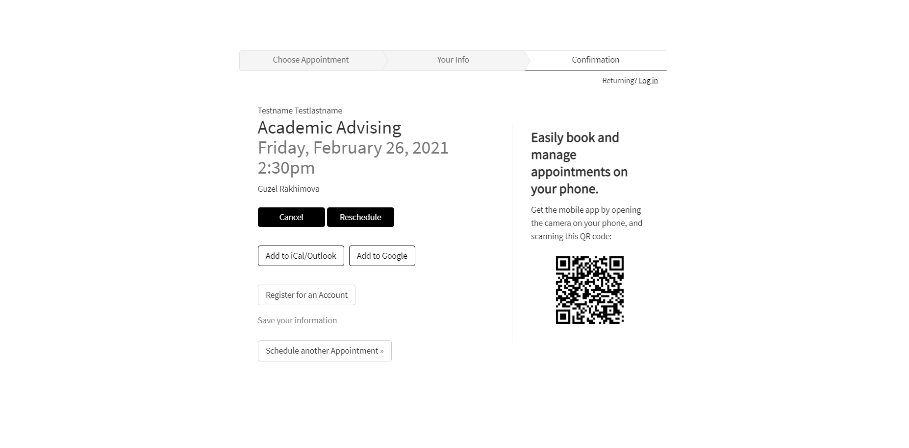
Scheduling Confirmation

Slide 21
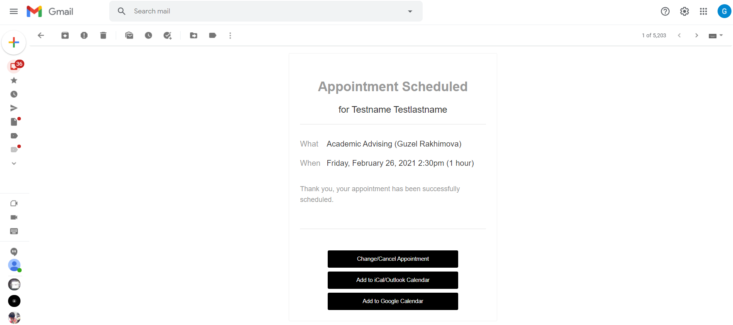
Email Confirmation

Slide 22
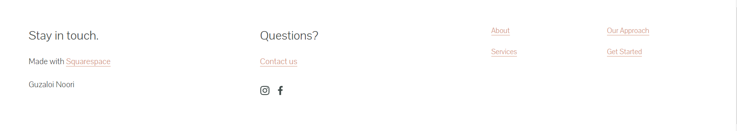
Bottom Page

Slide 23
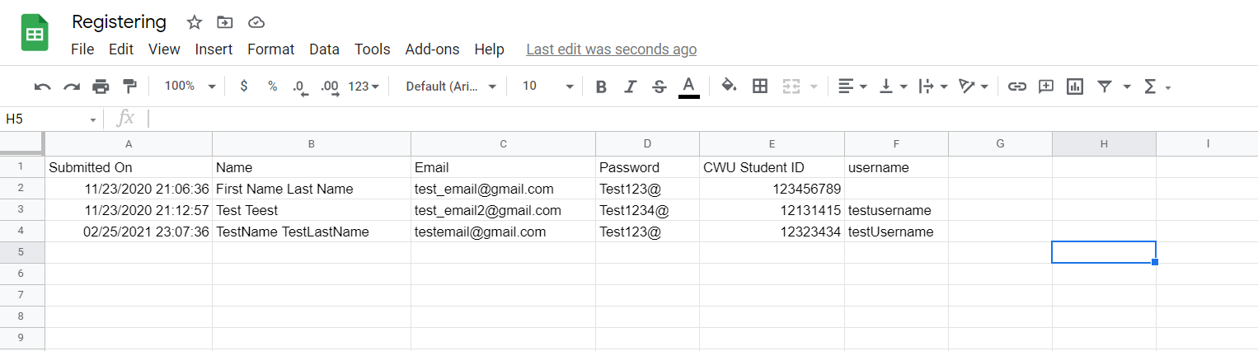
Registration Database

Slide 24
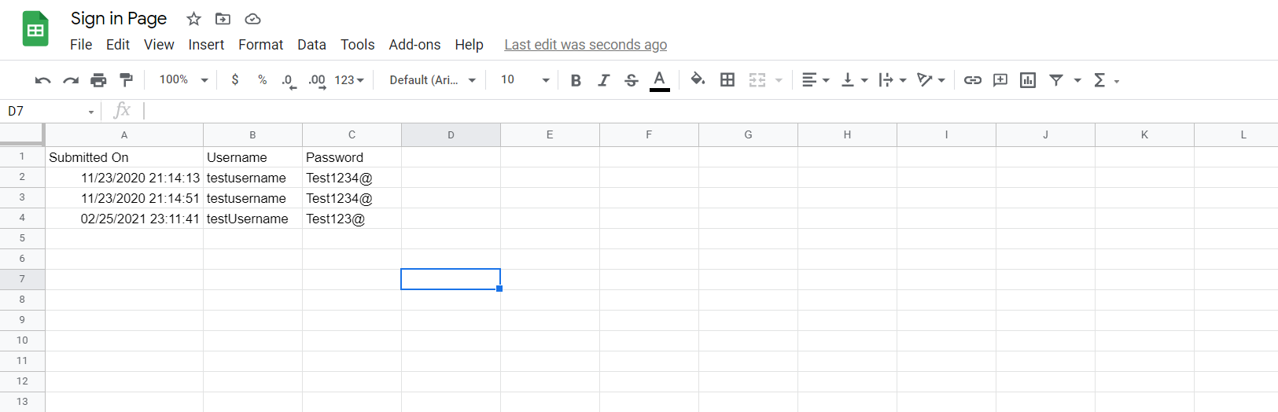
Sign in database

